Slide 1
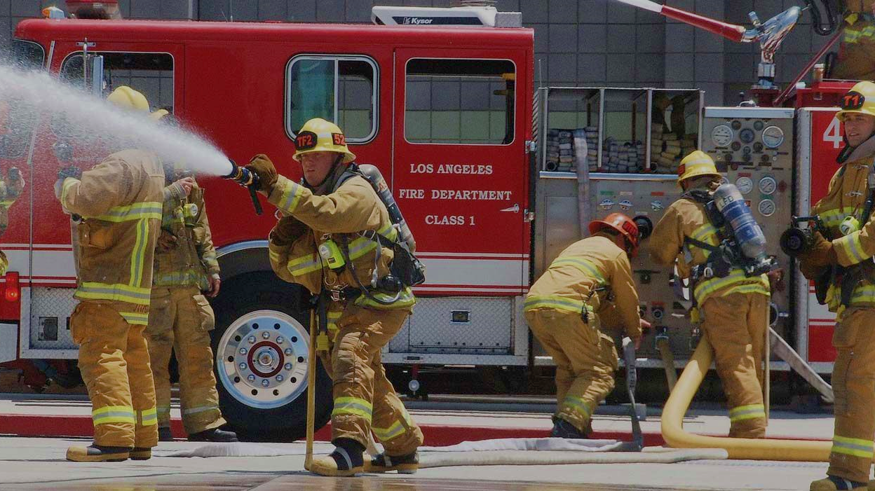

To Capture and Extinguish Fires 🔥
A Plugin for
Felix Disselkamp, Eva Langstein, Anne Staskiewicz
ヽ(*·ᗜ·)ﾉ 🔥ヽ(·ᗜ·* )ﾉ

Slide 2
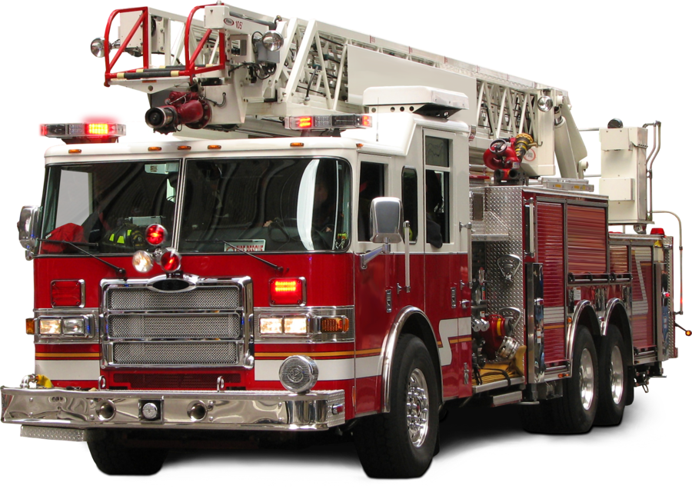
Overview of the functions
ヽ(*·ᗜ·)ﾉ 🔥ヽ(·ᗜ·* )ﾉ
Capturing Fires
The area
Attributes:
type: building, wildfire, industry etc.
Number of people in danger
Number of Casualties
Reinforcement? Yes/No
Deleting Fires
Finding the fastest route to the fire
Printing a pdf with some information for the file record
Optional: having a set number of fire trucks and having on record how many are not occupied
Adress of fire
Finding the closest firestation

Slide 3


Data
ヽ(*·ᗜ·)ﾉ 🔥ヽ(·ᗜ·* )ﾉ
Münster districts
House numbers
Data from Stadt Münster about fire stations

Slide 4

Why does it fit for this course?
ヽ(*·ᗜ·)ﾉ 🔥ヽ(·ᗜ·* )ﾉ
Creating a plugin is an easy way to distribute the functionality
We already have the data from Münster
We use the techniques we've learned in this course to create the plugin

Slide 5

Estimated time
21 h

Slide 6
Outline
ヽ(*·ᗜ·)ﾉ 🔥ヽ(·ᗜ·* )ﾉ
Brainstorming
Planning
Plugin
Creating the Interface
Qt Designer
2h
Plugin
4h
Creating the PPP
Creating the backend
Routing
Pdf
Save data to featureclass
Edit functionality
Analyze data
Car management
10h
Datasets
Create new cars and order them to different stations
See which car is currently not available
5h
Delete functionality
4h
2h
10h
5h
21h

